Slide 1
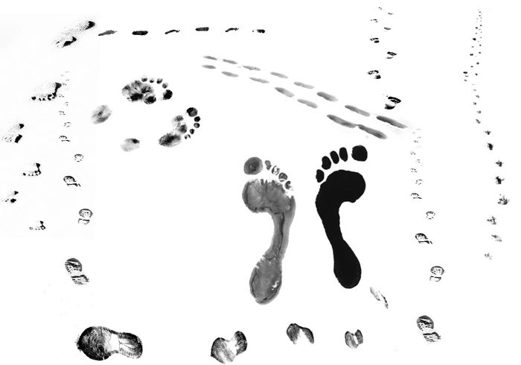
Two steps forward, one step back…
Chair’s Report 2018
Chair’s Report
2018

Slide 2
Disclosure of Relationships
Nothing to disclose

Slide 3
Learning Objectives
Revisit the DoM strategic priorities
Discuss progress, barriers & enablers to achieving these goals
Celebrate achievements
Review goals for the upcoming year
http://www.deptmedicine.utoronto.ca/events
→ click on “Events Photo Gallery”

Slide 4
It takes a village…
Clare Mitchell & our amazing staff
The PICs, Charlie Chan , DDDs, Monica Flak & Hospital/Divisional administration
Dr. Michael Farkouh, Joanna King & Research Committee
Drs. Jeannette Goguen, Eric Yu, Luke Devine, Cheryl Jaigobin & Janine Hubbard & the Education Executive Committee… and our education staff
Our Program Directors & Site Directors
Dr. Scott Berry & our CBD Committee
Dr. Sharon Straus, Lilian Belknap & the Mentorship, Equity & Diversity Committee
Drs. Kaveh Shojania & Brian Wong & the QI Committee
Dr. Arno Kumagai, Christian Base & CWMGR Committee
Drs. Frank Silver & Joan Wither, Lilian Belknap & CFAR Committee
Dr. Susan George & Senior Promotions Committee
Dr. Martin Schreiber & Senior Promotions Teaching Effectiveness Committee
Drs. Kevin Kain & CS Merit Review Committee
Tom, Shiva & the Dept Appointments Committee
Brianne & Communications
Chris & Advancement
Dr. Eliot Phillipson & Awards Committee
Our Residents and Fellows
Our Faculty
Our patients & their families

Slide 5
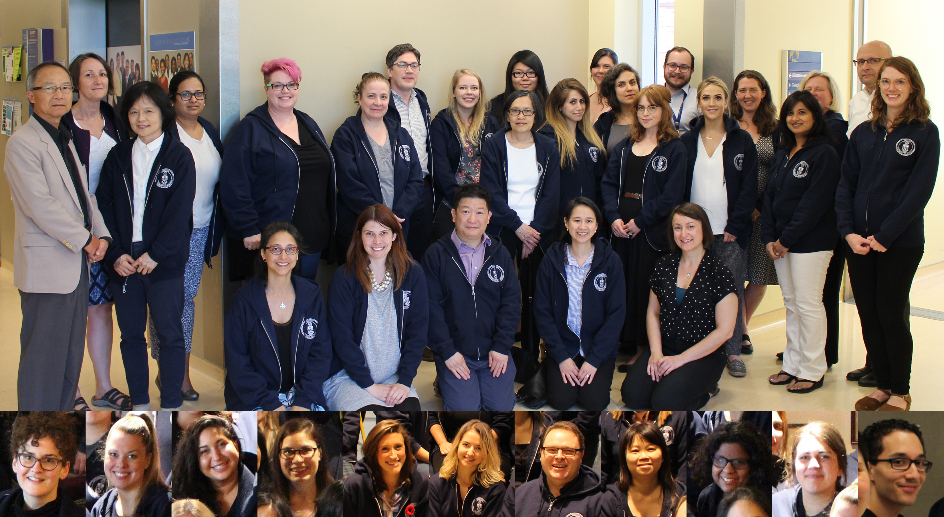
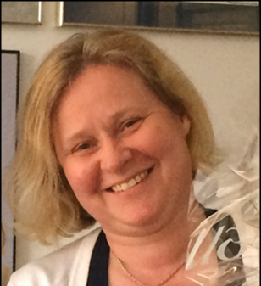
DoM Staff

Slide 6
2014 DoM Retreat
STRATEGIC PRIORITIES 2015-18 (guiding principles)
  Patients first
  Equity, diversity & professionalism
  Social accountability
  Training to meet population needs
  Generation & translation of new knowledge to impact health
  Valuing all (all our faculty members; hospital & university identities)
  Mentorship across the academic lifespan
  Fundraising to achieve these goals
January 2018: Shared accomplishments & laid out next steps

Slide 7

Highlights of 2017-18

Slide 8
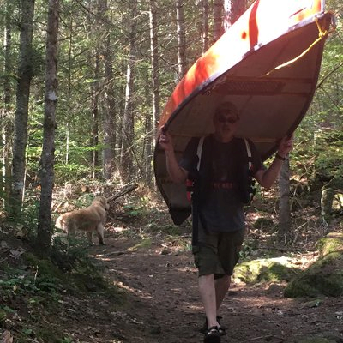
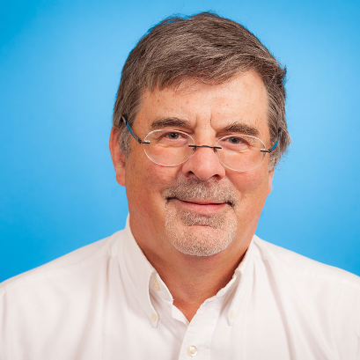
Lead, Patient Involvement
Andreas Laupacis

Slide 9


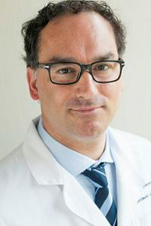
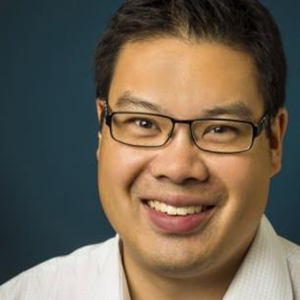
Quality & Innovation
Kaveh Shojania
Vice Chair, Quality & Innovation
Brian Wong
Director,
Co-Curriculum in QI

Slide 10
Clinicians in Quality & Innovation
Recruitment of CQI n=46
Most divisions have 1-3 CQI faculty
71% “CQI” faculty in 1st 5 yr of career

Slide 11
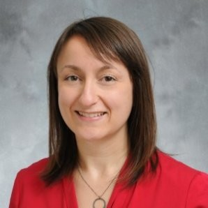
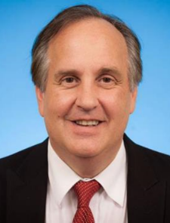
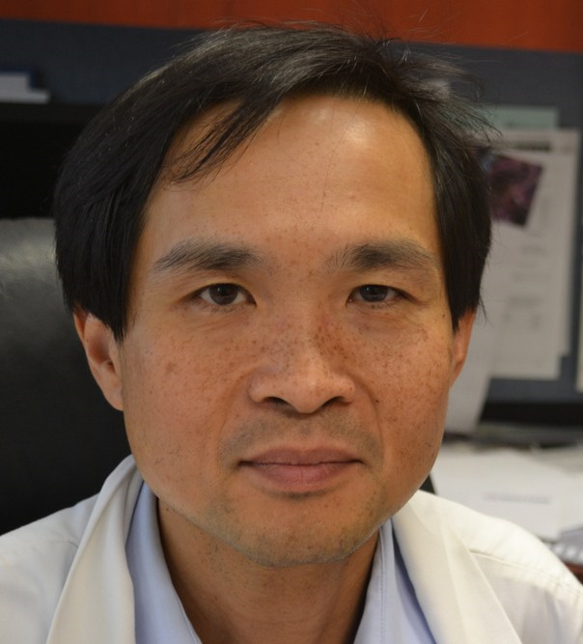
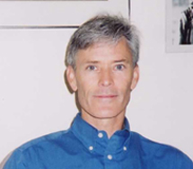
Research
CS Merit Review
Awards committee – enormous success!
 | 2013 | 2014 | 2015 | 2016 | 2017
Tri-council | 29M | 26M | 26M | 28M | 30M
Other | 103M | 101M | 105M | 95M | 108M
Industry | 29M | 27M | 29M | 33M | 43M
CFI | 0 | 47K | 820K | 122K | 5M
Total | 161M | 154M | 162M | 157M | 185M

Slide 12
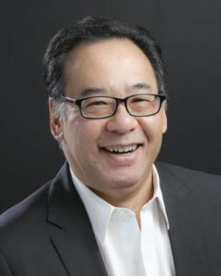
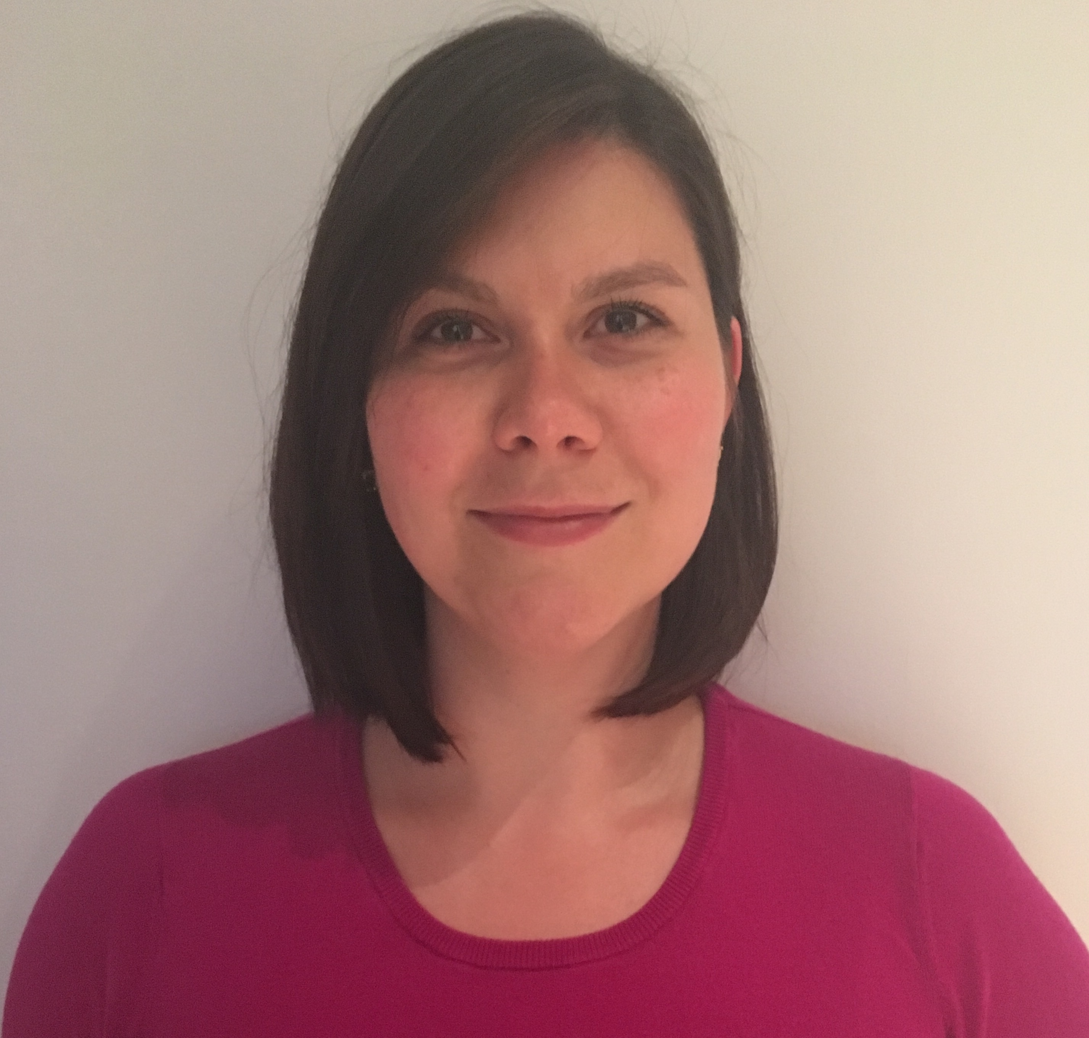
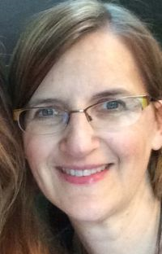
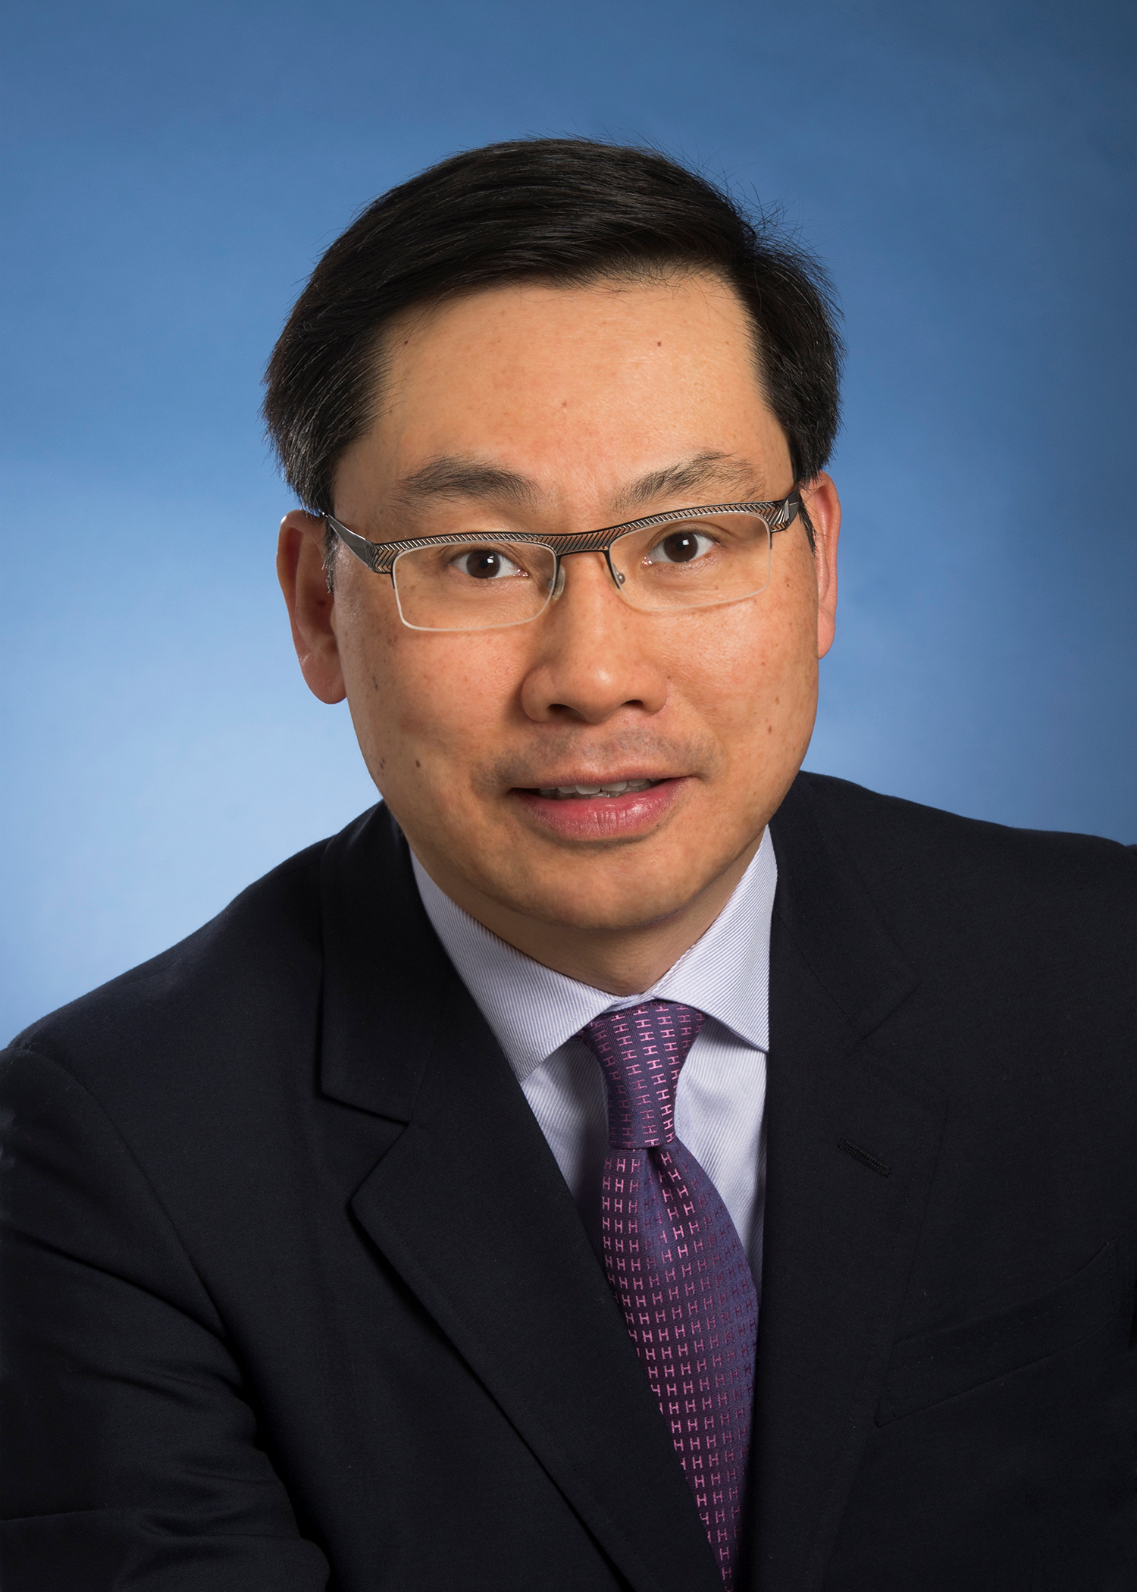
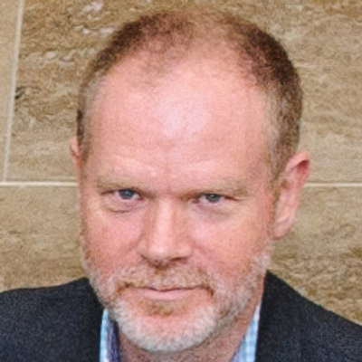
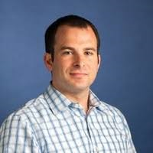
Teaching & Education
Competency Based Education launched
Core Medicine entering Phase 2 of the CBE pilot
  Academic Advisors recruited

Slide 13
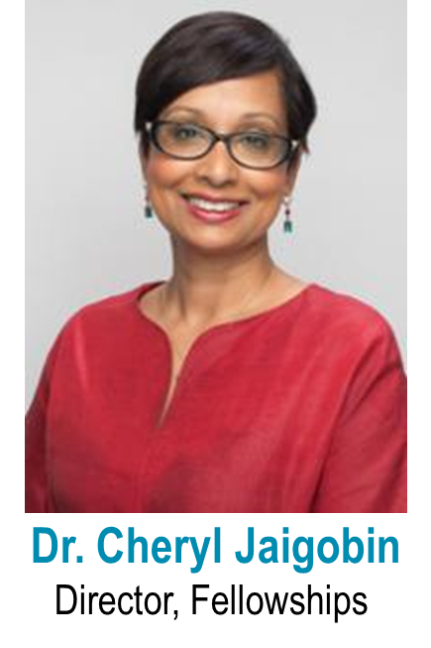
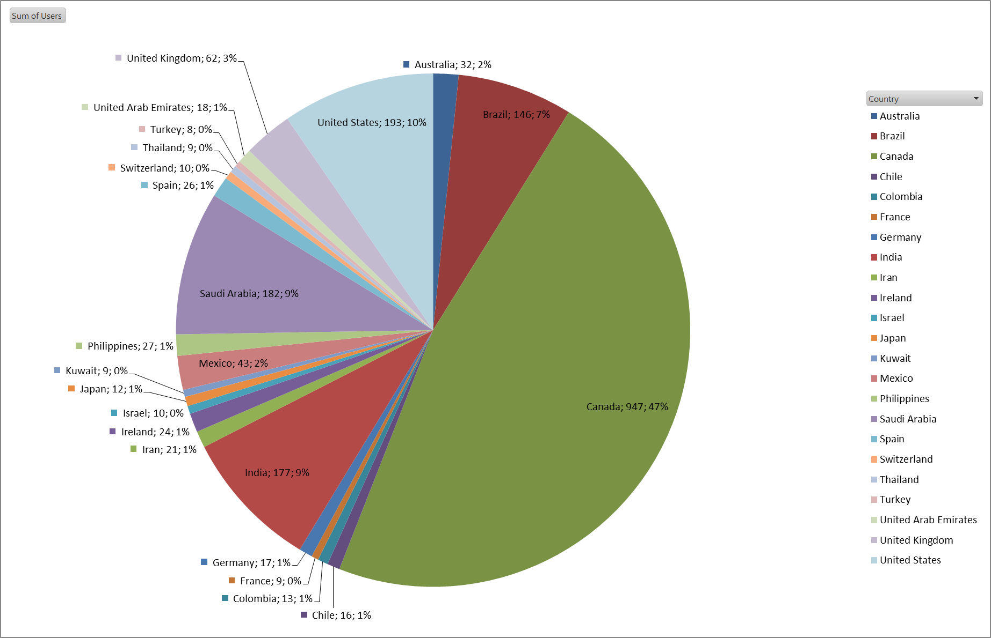
Fellowships
Reviewing all fellowships against standards to enhance experience & outcomes
>2000 visits to our website

Slide 14
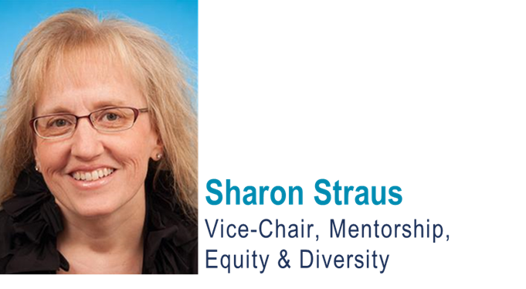
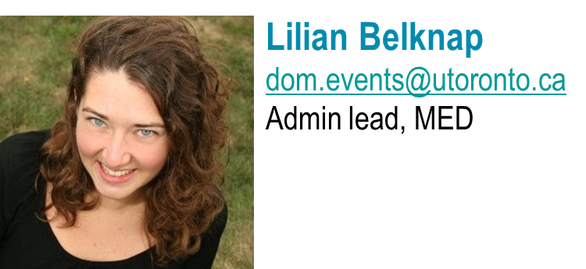
Equity & Diversity
Now woven into the fabric of the department’s decision-making

Slide 15

We’ve learned that…
Being a woman can negatively impact academic career advancement … similar for other under-represented groups
Leaders (colleagues) may not ‘see’ the problem (personal experiences) OR why it’s necessary to address the problem (business case for diversity)
TIME alone is insufficient to address biases
Second Summit on Women in Academic Medicine (WAM)
Feb 28 2018

Slide 16
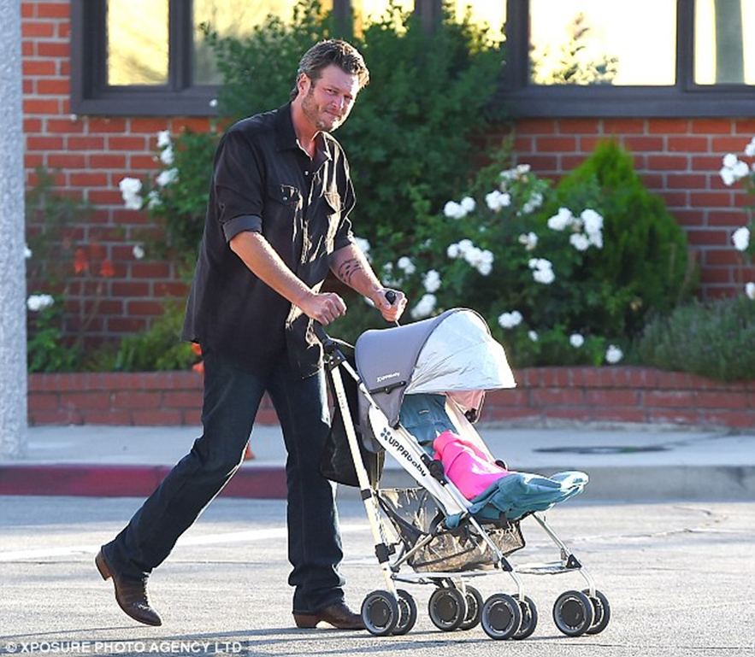
Superhero or deadbeat dad?

Slide 17

DoM Socio-Demographics
30% identify as ‘person of colour’ or visible minority
Race/ethnic group:
  White / Caucasian 60%
  South Asian 13%
  East Asian 12%
  Middle Eastern 2%
  Black 2%
  Southeast Asian* 1%
  Other 3%
  Prefer not to answer 7%
*Southeast Asian: Filipino, Cambodian, Indonesian, Laotian, Vietnamese, Thai, etc.
South Asian: Indian, Pakistani, Sri Lankan, East Indian from Guyana, etc.
East Asian (Chinese, Japanese, Korean, etc.)

Slide 18
Communications “run chart”
≈ 30,000 page views per month
New website launched
Divisional landing pages & sites
Notes:
Does this qualify as a positive trend for QI??

Slide 19
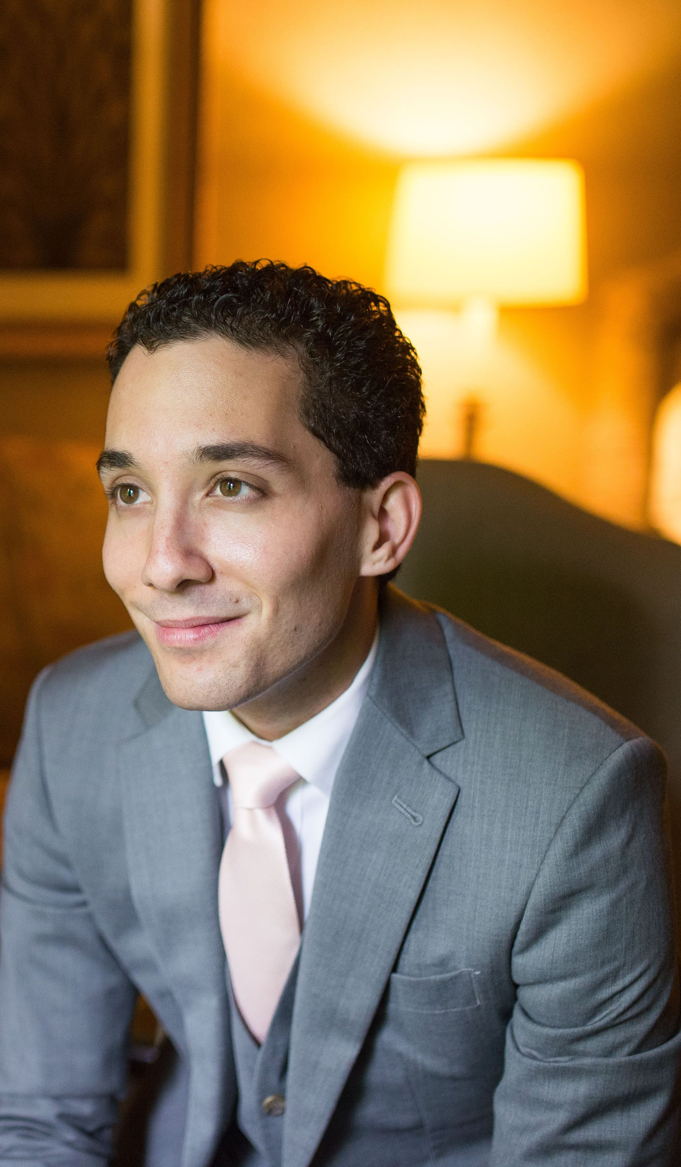
Advancement
Raised $6.7M (FY ending June 30 2018)
  Divisional & joint hospital-University fund-raising
Physician Scientist pipeline business case for support
Insulin 2021: Scientific Symposium save the date coming soon; Gala event…
2019 celebration of 100 year of Eaton endowment

Slide 20
Continuing Faculty Appointment Review
44 reviews completed!!
  Included senior recruits for first time
Demonstrated teaching effectiveness & professionalism
CI/CS timing
Check-in at 1.5 years to ensure ready for CFAR… address issues re mentorship, resources, fit of position description

Slide 21

Induction of Master Clinicians

Slide 22

Department of Medicine
ANNUAL DAY
Monday, June 18, 2017
Gardiner Museum
111 Queen’s Park, Toronto
#DoMAnnualDay

Slide 23

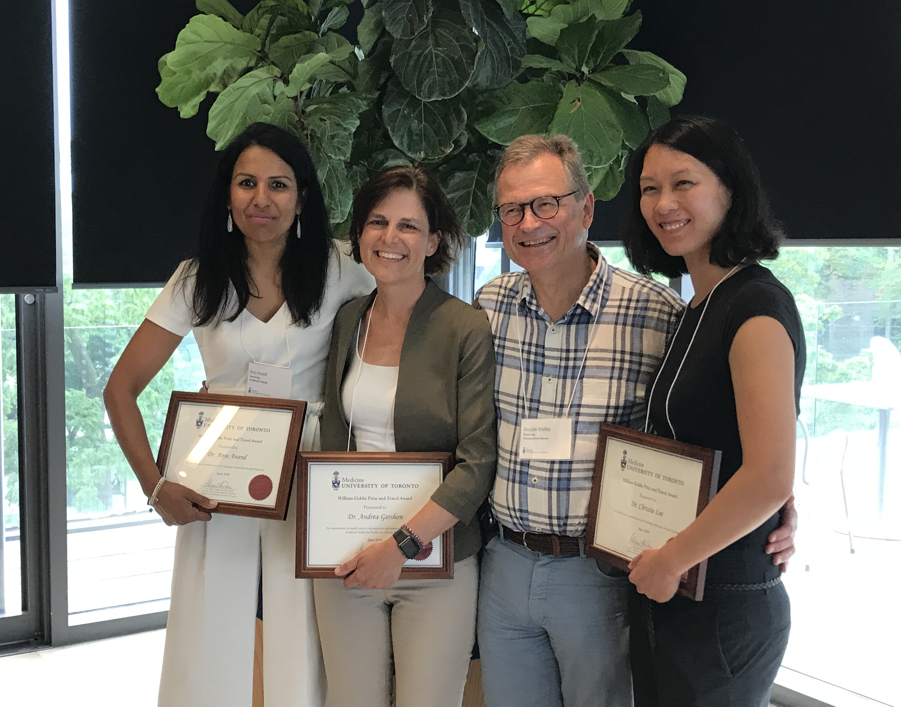
Kaveh Shojania
Robert Hyland Award for
Excellence in Mentorship
Scott Walsh
Teacher of the Year
Monika Kryzanowksa
Award for Quality & Innovation
Murray Krahn
Eaton Scholar
Researcher of the Year (clinical)
Aaron Schimmer
Eaton Scholar
Researcher of the Year (basic science)
William Goldie Awards
Jerome Leis
Quality and Innovation
Andrea Gershon
Research
Anju Anand
Education Scholarship
Christie Lee
Excellence in Teaching

Slide 24
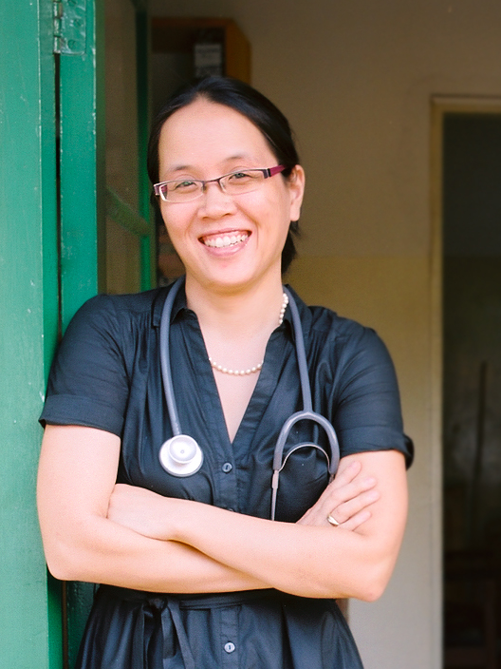
Adrienne Chan
Award for Humanism in Medicine
Notes:
Assistant Professor in Division of ID at Sunnybrook

Slide 25

Paul Dorian
Department Division Director,
Cardiology
Gordon Sussman
Department Division Director,
Clinical Immunology and Allergy
Johanne Allard
Department Division Director,
Gastroenterology
Linn Holness
Department Division Director,
Occupational Medicine
David Tang Wai
Program Director,
Neurology
Margaret Thompson
Program Director,
Clinical Pharmacology and Toxicology
Maria Cino
Program Director,
Gastroenterology
Joanne Bargman
Fellowship Director,
Nephrology
Notes:
Dr. Pritchard's greatest strength is her ability to motivate and inspire her colleagues, co-workers and trainees to fulfill their greatest potential.
She is honest, fair and thoughtful.
Her leadership style builds consensus but she is not afraid to make a firm decision.
Dr. Pritchard is also very humble and has taught me the importance of treating everyone equally with the utmost respect irrespective of their stature or importance within the organization.
Kathy truly seems to put the good of others: patients, colleagues, the Division, first in all of her decision-making.
▪
Kathy is a natural leader. She's warm, genuinely caring and she has been highly effective in her role as DDD.
▪
I would say Dr. Pritchard's greatest strength as a leader is her ability to collaborate. She takes great interest in other people's ideas and finds ways to bring people together to work productively.
▪
Has a vision and can help others see and share that vision and gets things done (strategic plans)
integrates (different locations of the division of medical oncology; faculty with different job descriptions, different research interests)
kind - excellent role model and mentor for others; serious commitment to academic mission;
▪

Slide 26
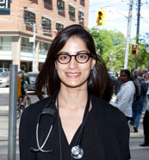
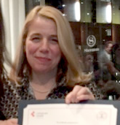
2017 Faculty Survey
Faculty survey every two years takes ‘pulse’ of DoM
Assessed career satisfaction, work-life integration, mentorship, teaching, research, equity & diversity, professionalism & socio-demographics
Results have been summarized in Chair’s Columns… available online http://www.deptmedicine.utoronto.ca/newsletter
Reena Pattani & Karen Burns
Co-Leads 2017 Faculty Survey

Slide 27

2017 Faculty Survey
414 respondents (52% response rate)
  166 women + 248 men
  Respondents highly reflective of faculty by age, sex, hospital, division, rank

Slide 28
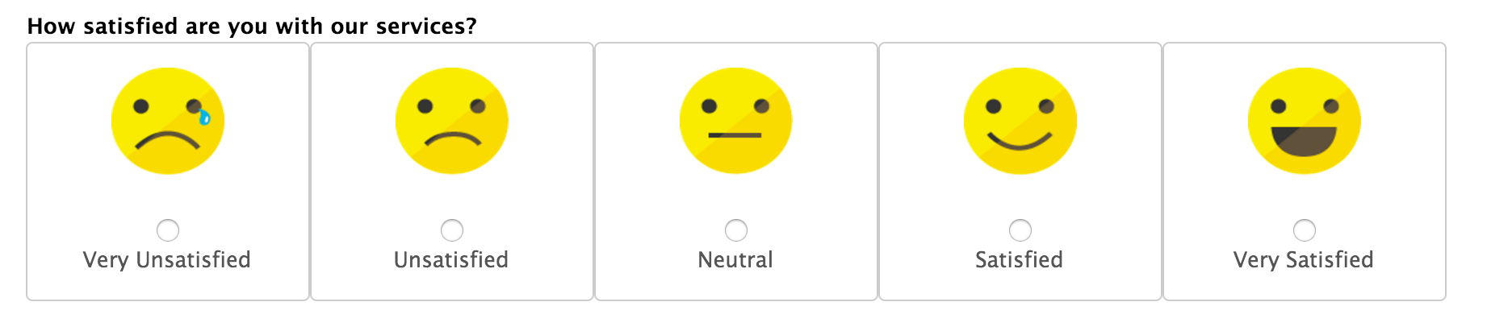
Career Satisfaction
>84% reported career satisfaction
CQIs & CIs > likely than others to report dissatisfaction with institutional support & time available for scholarly work

Slide 29
Clinician Investigators
General sense of being ‘orphaned’
Compared with CS faculty, perceived …
  Less valued
  Less access to research support / resources (RI, merit, start up, etc.)
  Greater pressure re clinical work

Slide 30
Promotion 2015-16: CI vs CS
2015: removed expectation for PI grant (not mini-scientists!)

Slide 31
Work-life integration
~50% felt work doesn’t allow for sufficient personal/family time (> in CI, CQI)
Sense of lack of resiliency in the system to buffer against stressful events
  > cause of burnout than the actual quantity of work
Discomfort raising personal/family considerations when scheduling work obligations (women > men)
  Due to concerns re career advancement
Contextual factors
  Clinical demand
  Culture (e.g. fairness & transparency)
  Mentorship

Slide 32
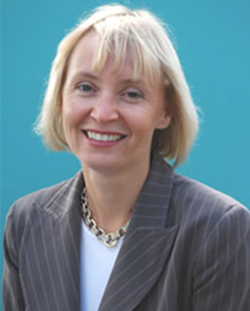
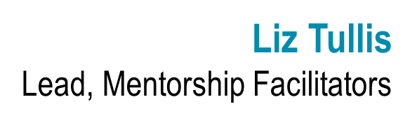
Mentorship
47% had a formal mentor & 76% an informal mentor
  Women, early career > men, later career
  Difficulty establishing/maintaining a mentorship relationship
66% satisfied with quality of mentorship (45% in 2015)
40% providing mentorship
  Dissatisfaction with recognition of mentorship (e.g., promotion)

Slide 33
Teaching
60-65% felt teaching contributions valued
Perceived unequal (unfair) distribution of teaching responsibilities (CTs, CQIs)
Many felt too few TES
Most felt trainee evaluations affected by broader issues, e.g. clinical work loads
40% agreed evaluations of trainees influenced by fear of retribution for constructive (negative) feedback

Slide 34
Research (those who reported doing research)
General unhappiness with interactions with research institutes
Variability in extent to which faculty perceived their research contributions to be valued & satisfaction with research support
  CIs < CSs

Slide 35
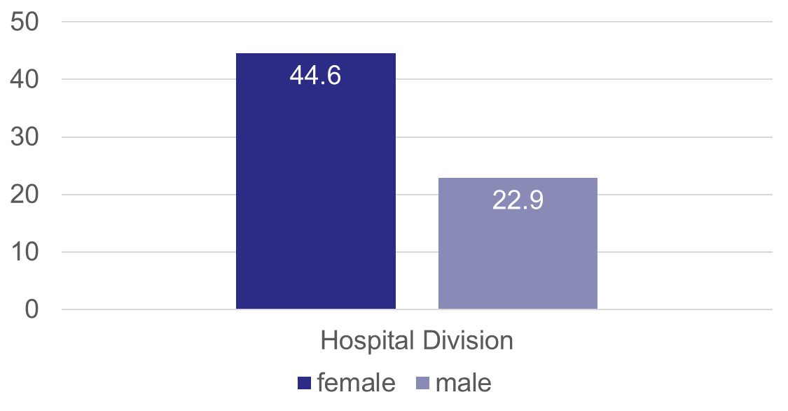
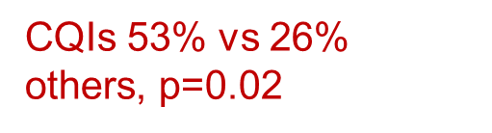
Equity, Diversity & Professionalism
87% of respondents agreed that the people they work with interact respectfully
  Variability in response by hospital and division
Women & CQI faculty ~ 2X more likely than others to report feeling excluded from a social network, have to work harder to be perceived as a legitimate scholar

Slide 36
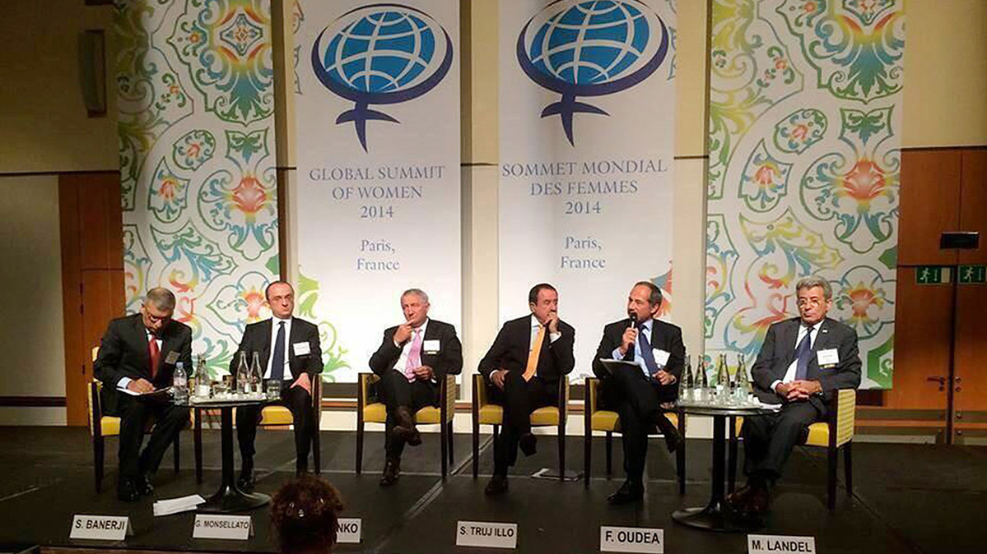
Unconscious bias training
< 1/5 had received training (increased with rank)

Slide 37
Witnessed unprofessionalism
48% had witnessed ‘unprofessionalism’
38% had experienced such behaviours
  Disrespect, bullying, eye rolling, explicit favoritism, exclusion from activities, ageism, unwillingness to pitch in clinically, swearing, and name-calling

Slide 38

Barriers to addressing professionalism
Lack of confidence (trust, belief) that action will be taken
Lack of clarity regarding what constitutes “unprofessional behavior”
Fear of reprisal (only 51% ‘very confident’ they could address incivility (43% assist., 58% assoc. and 66% full professors)

Slide 39
Unprofessional behavior includes:
Creating a hostile environment
Intimidation, harassment or discrimination
Failure to identify, disclose, or manage conflicts of interest
Inappropriate relationships with industry
Violation of boundaries
Repeated failure to be available for scheduled duty, including teaching & chronic lateness
Reporting for work when unable to perform required duties
Failure to fulfill academic obligations (e.g., inadequate supervision, being unavailable to learners, or failure to hand in evaluations in a timely fashion)
Failure to complete professional obligations (e.g., required clinical records and reports in a timely fashion)
Failure to cooperate with investigation / management of alleged breaches of professional conduct
http://medicine.utoronto.ca/sites/default/files/standards.pdf

Slide 40

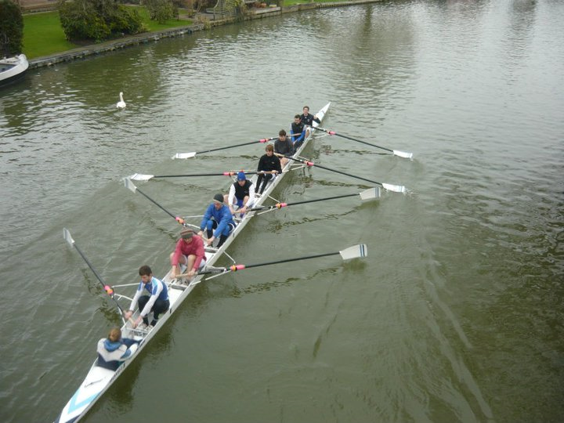
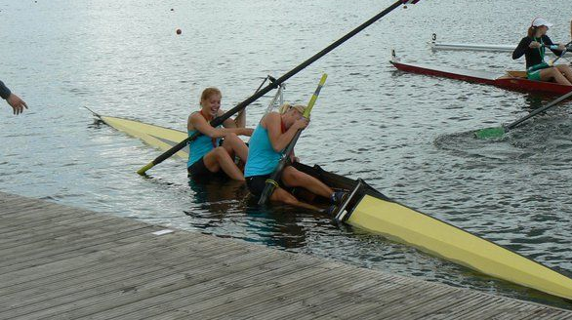

Slide 41


Slide 42
To Do…
Integration of patient perspectives into our work
Mentorship
  Revisit when/how/who to assign mentors (Mentorship Facilitators)
  Clarify expectations & responsibilities of mentors & mentees
  Valuing mentorship
CFAR preparedness
  Mid-way check-in
Teaching & Education
  Clarify teaching expectations (formal, informal) by job description
  Expand opportunities for learners to gain skills to keep complex medical patients OUT of hospital

Slide 43
To Do…
Valuing ALL
  Focused attention to CQI & CI groups
  Report of Task Force on Valuing the CT
  Appoint DoM Lead for Wellness – posting this fall
Equity, diversity
  Continue to challenge each other (leaders, faculty, learners, allied health, nursing) to create a climate of inclusion
  Unconscious bias education for all committees
Professionalism
  Zero tolerance
  Procedural fairness in addressing complaints of incivility

Slide 44

Notes:
Provide a (very brief) overview of the Sir John and Lady Eaton Professor/Chair + note the significance of the original $375K gift (equivalent to $5.3M today) for the practice of academic medicine
Highlight how the Professor/Chair was the first example of protecting time
Express how honoured you are to be the Chair holder as we are coming up on 100 years of its existence
Then perhaps end with a remark about how excited you are to see what the next 100 years will bring + convey how grateful you are to the Eaton family (ask John and Fred to stand) and Mr. John Craig Eaton for committing to ensure that the next 100 years are just as successful as the last by having pledge a new $1M in honour of the 2019 celebration (round of applause). You can also comment how wonderful it’s been for you to get to know John and Fred over the last 4-5 years (if you want).
In effect this kicks off the 2019 ‘celebration”

Slide 45
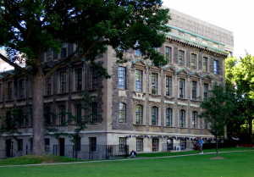
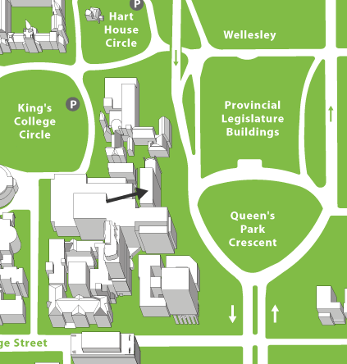
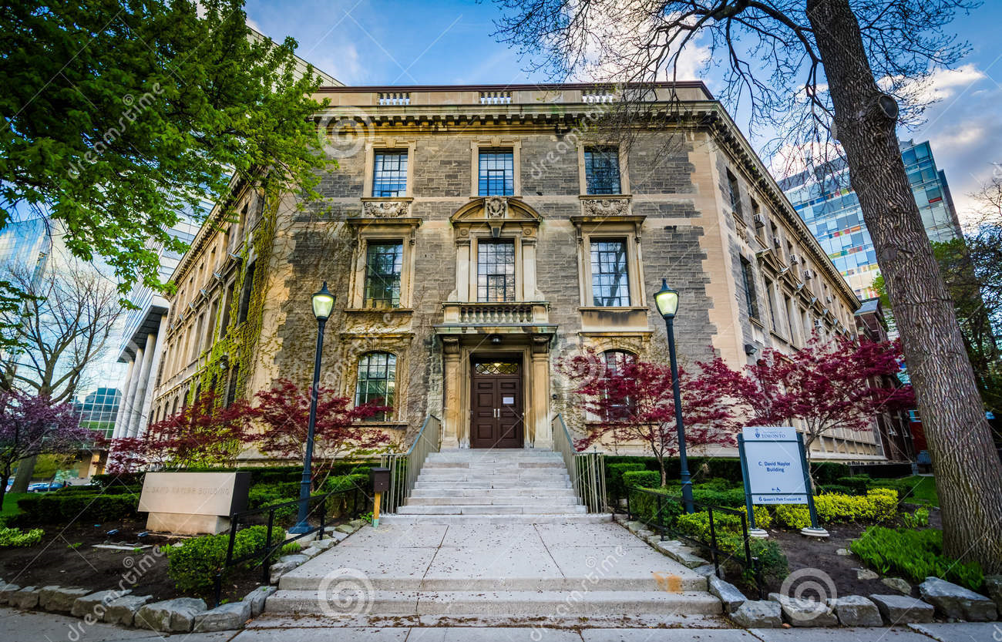
MSB
We’re moving!

Slide 46

December 3 & 4, 2018

Slide 47
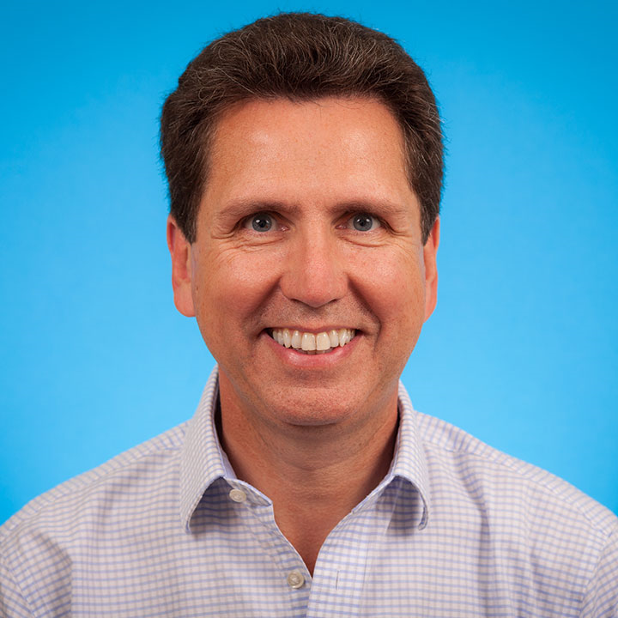
Tom Parker
Physician in Chief of Medicine
St. Michael’s Hospital
Notes:
He has won several faculty-wide, hospital-wide, and academy-wide awards for excellence in Clinical Teaching including the Faculty Mary E. Hollington and W. T. Aikins Awards.
He is the Director of the Department of Medicine’s Master Teacher Program, which focuses on the faculty development of clinical teaching skills – the program won the inaugural Faculty-wide Helen P. Batty Faculty Development Award for Program Excellence in 2005.
Thoughtful, wise, humble. A tremendous mentor and role model. A consensus builder. His leadership reflects his personality.
Most recently, recipient of the Gladstone and Maisie Chang Chair in Teaching of Internal Medicine, University Health Network

Slide 48


Slide 49
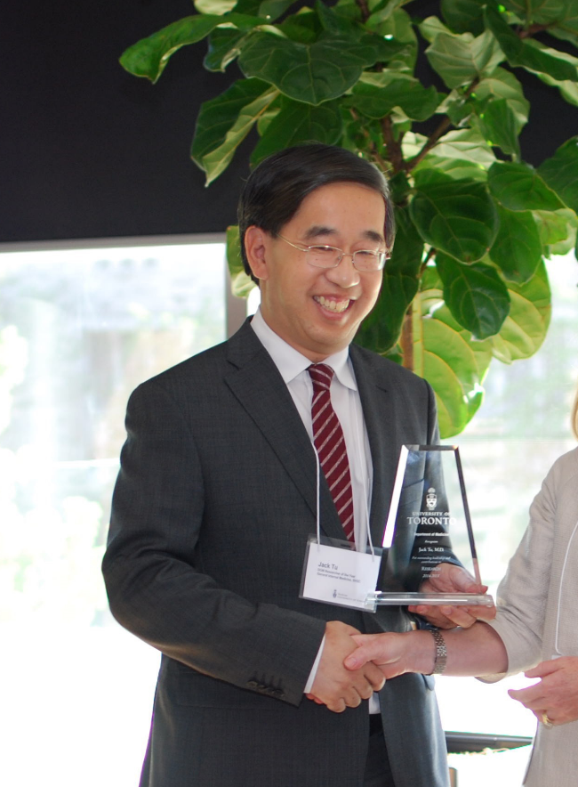
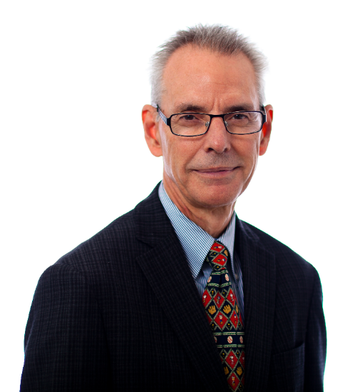
Jack V Tu
Clinician Scientist, GIM & Cardiology
Sunnybrook, IHPME, ICES
Mike Freeman
Clinician Teacher, Cardiology
St. Michael’s Hospital
Notes:
Staff photo

Slide 50

Summary
Faculty survey has identified areas to target for intervention & areas requiring further investigation (CI, CQI)
  2019 survey topics???
Upcoming five-year review followed by strategic planning
Thank you for all you do!!

Slide 51
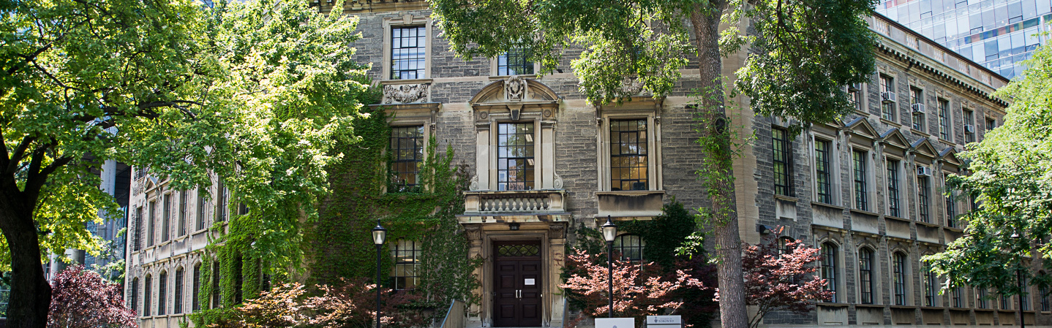
Have a great summer!

